Slide 1
Active-Routing: Compute on the Way for Near-Data Processing
Conference : HPCA’19
Author : Jiayi Huang, Ramprakash Reddy Puli, Pritam Majumder, Sungkeun Kim, Rahul Boyapati
Institution : Texas A&M University, NVIDIA, Intel Corporation

Slide 2
Problem
Near-data processing (NDP) has driven new architectures to move computations near data-resident locations, such as cache and memory. However, they are suboptimal when performing simple tasks over a large size of raw data, such as dot product, since they need to fetch part of the data across the memory network for further processing when data are not located in the same module that incurs communication and energy overhead.

Slide 3
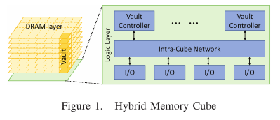
Background
Die-Stacked Memory
Figure 1 shows the organization of HMC, which is partitioned vertically into several vaults consisting of multiple TSV connections to the logic layer. Each vault is controlled by a vault controller implemented on the logic die. HMC communicates with processor or other memory cubes through four ports. Inside the cube’s logic die, an intra-cube network is used to route the packets between the vaults and ports.

Slide 4
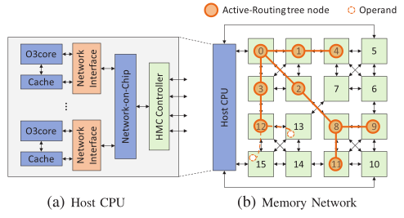
Background
Memory Network
HMCs can be chained together to form a cost-effective memory network using packet switching and provide large memory capacity.
In-Network Compute Potential
With high-bandwidth and large memory capacity provision, a memory network is adopted to scale PIM architectures for accelerating data-centric applications. One unsolved problem of such a system is how to determine the compute point for data located remotely. This computation can be mapped to a data-flow graph and naturally scheduled as network flows along with computation.

Slide 5
Solution
This paper propose Active-Routing, an in-network compute architecture that enables compute on the way for near-data processing. Active-Routing examines the idea of mapping compute kernels to the memory network for data-flow style processing by exploiting the pattern of aggregation over intermediate results of arithmetic operators.

Slide 6
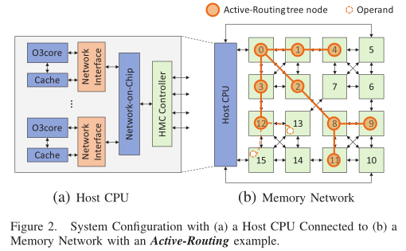
Challenge and Technique
How to design in-network compute architecture to enable compute on the way for near-data processing?
Figure 2 presents the system configuration, where host processors are connected to a memory network formed by chaining HMCs.
e.g. sum += A[i]×B[i]
Each computation of A[i]×B[i] is offloaded from host CPU to memory network as an Update packet. After Update offloading, a Gather packet is sent to collect the partial results from each cube, and reduce them in the network routers on the way back to the host.

Slide 7
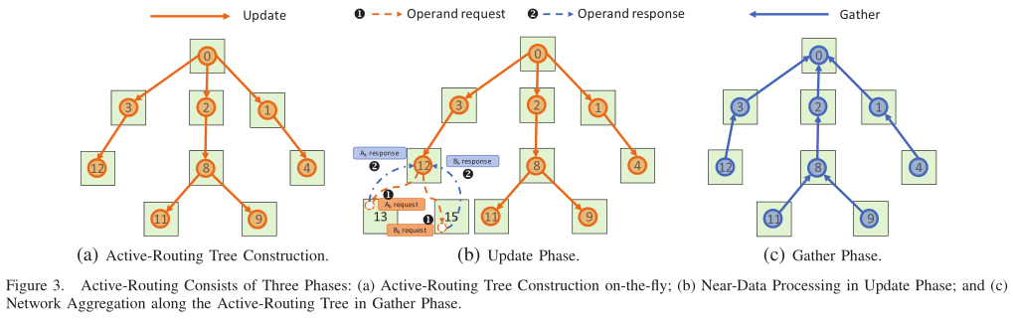
Challenge and Technique
How to map a compute kernel in-memory network to optimize reduction over intermediate results of arithmetic operators?
This paper proposes a novel mechanism with three-phase packet processing: Active-Routing Tree construction, Update Phase for data processing, and Gather Phase for Active-Routing reduction.

Slide 8
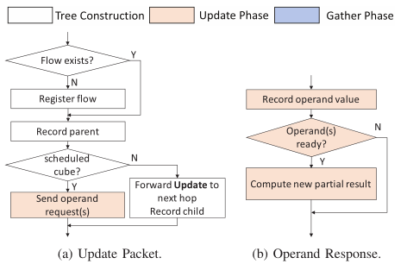
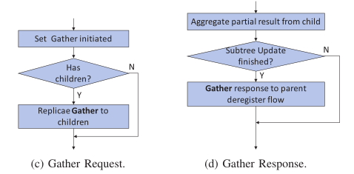
Challenge and Technique
This paper proposes a novel mechanism with three-phase packet processing: Active-Routing Tree construction, Update Phase for data processing, and Gather Phase for Active-Routing reduction. We name such a mapping as
an Active-Routing flow. A unique identification (flow ID) is assigned for each flow and its corresponding ARTree.

Slide 9
Challenge and Technique
How to alleviate overhead occurred by instruction offloading and operand fetching?
Memory access patterns of operand fetching can be exploited to amortize the overhead by offloading multiple operations at a time.
1. regular-regular access pattern: offload the computation in cache block granularity as vector processing.
2. regular-irregular access pattern: fetch the irregular data and send them to regular data resident location for
Processing.
3. irregular-irregular memory access pattern: simply fetch single operand pairs to the scheduled compute node as scalar operations.

Slide 10
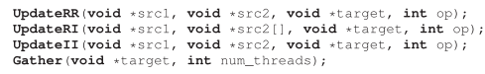
Implementation
Programming Interface and ISA Extension
Active-Routing provides simple programming interfaces (Update and Gather) to translate the program semantics into extended instructions. The Update API carries two source memory addresses of an arithmetic operation. The target field in both APIs is the address of the reduced variable, which is hashed to a unique identification for each flow.
During execution, instruction fields are written to a set of dedicated registers in the Network Interface (NI).
NI can assemble this information into an Update or a Gather packet and send it to the memory network.

Slide 11
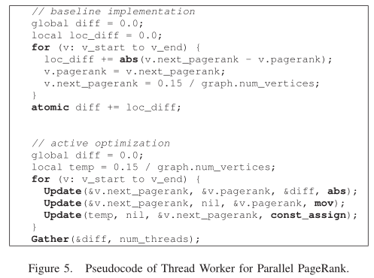
Implementation
Programming Interface and ISA Extension
Figure 5 shows the baseline and Active-Routing implementations of the thread worker pseudocode of pagerank calculation kernel.

Slide 12
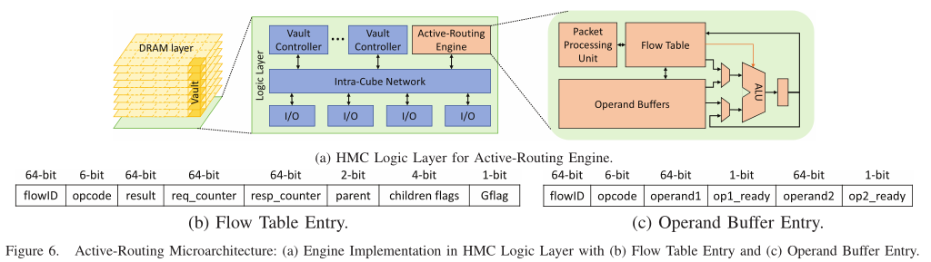
Implementation
Active-Routing Engine
The Active-Routing functionalities are implemented in Active-Routing Engine (ARE) on the HMC logic layer as
shown in Figure 6 (a). Packet processing unit is responsible for decoding the Update and Gather packets and schedule actions correspondingly. Flow table keeps track of both the structure and states information of each flow. Operand buffer is used as a temporary storage for the operands waiting to be processed. Active-Routing supports various operations on different data types, including reduction operations such as sum, xor, and, min, and max, as well as multiply-accumulate on floating point and integer data.

Slide 13
Implementation
Enhancements in Active-Routing
(1) the decision for choosing the root of a tree affects the network congestion.
The first one uses thread ID to interleave the candidate cubes so as to balance the trees rooted from four corners among multi-thread applications, named as ART-tid. Another enhancement technique takes the operand addresses into account and sends the Update packet through the port nearest to its destination, named as ART-addr.
Since these two schemes can create multiple ARTrees for one flow, the extended HMC memory controllers that manage the trees are coordinated to merge the subflows at the end of Gather Phase. On the contrary, Naive-ART constructs only one ARTree for each flow.

Slide 14
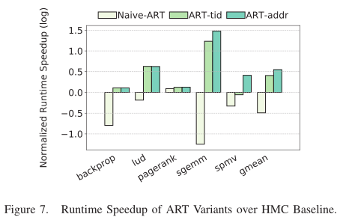
Implementation
Enhancements in Active-Routing
(2) the overhead of offloading computations widely varies with the change in its granularity.
To reduce offloading overhead and number of memory accesses, we adapt the offloading granularity, to exploit the data locality of different memory access patterns.

Slide 15
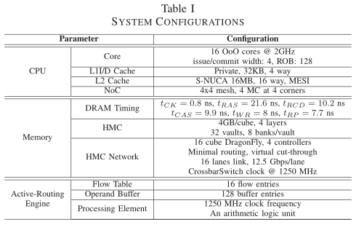
Evaluation
System Modeling and Configuration
We use an execution-driven simulator McSimA+ with detailed microarchitecture models as backend for cores and cache hierarchy. For HMC memory modeling, we integrate a cycle-accurate simulator CasHMC with McSimA+ to replace its memory system.

Slide 16
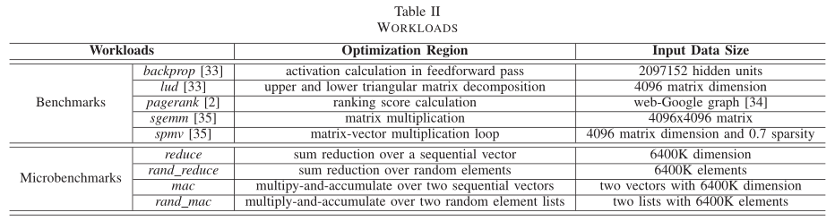
Evaluation
Workloads
Active-Routing targets applications that have abundant reduction on data processing operations such as multiply-accumulate or pure reduction operations over a large memory footprint.

Slide 17
Evaluation
PEI
we evaluate ART-tid and ART-addr with respect to PEI^{[1]}, implemented by adding a computation
unit at each vault controller supporting PEIs. It can compute a dot product of 2 4D vectors in a cycle, one of the vector opearnds (either regular or irregular) are brought to cache and send to the memory location of the other half (should be regular) for processing in memory.
[1] proposes a mechanism to dynamically track locality of data accessed by PEIs and execute PEIs with high data locality on host processors instead of offloading them to memory, in order to exploit large on-chip caches.
[1] J. Ahn, S. Y oo, O. Mutlu, and K. Choi, “PIM-Enabled Instructions: A Low-Overhead, Locality-Aware Processing-in-Memory Architecture,” in International Symposium on Computer Architecture (ISCA), pp. 336–348, IEEE, 2015.

Slide 18
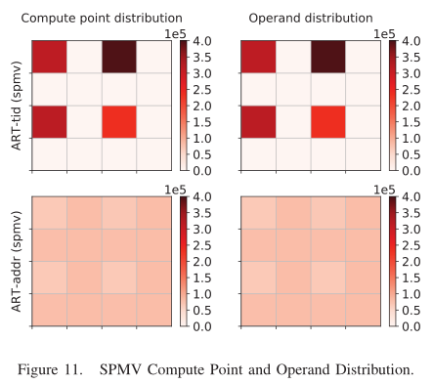
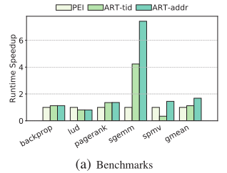
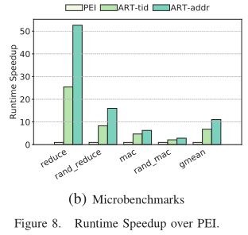
Evaluation
Speedup
The results show more than 6% performance improvement across various of applications with respect to PEI except lud.

Slide 19
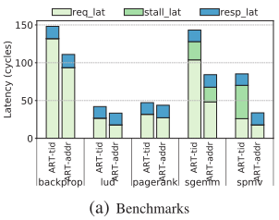
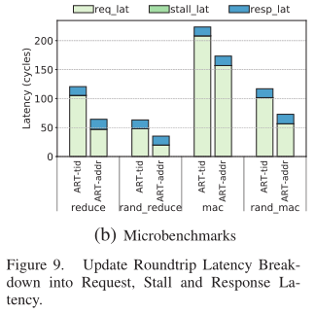
Evaluation
Update Offloading Roundtrip Latency
The ART-tid/addr schemes can balance the load evenly and utilize the memory network resources more efficiently. Compared to ART-tid, ART-addr has lower round-trip latency across all benchmarks. The stalls are mostly due to queuing in HMC controllers.

Slide 20
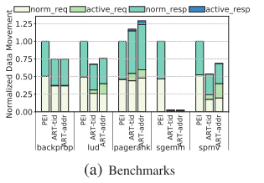
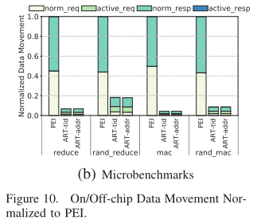
Evaluation
Data Movement
We evaluate data movement as the data size transfered between the host processor and memory
network. For most applications, ART-tid/addr can reduce the memory requests fetching the data, mostly source operands, compared to PEI.

Slide 21
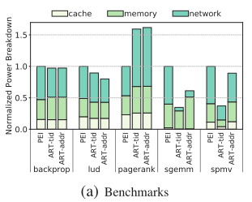
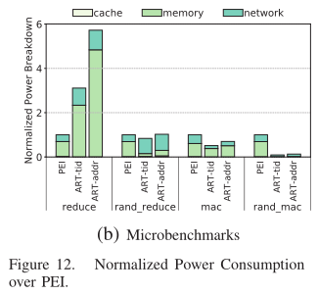
Evaluation
Power Consumption
We observe that ART-tid/addr consume similar memory power and less network power than PEI except for pagerank.

Slide 22
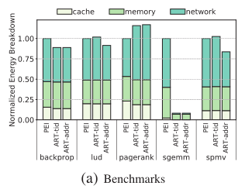
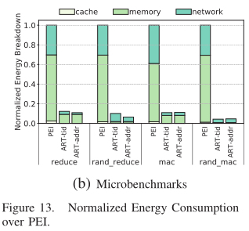
Evaluation
Energy Consumption
ART-tid/addr reduces the energy consumption across all the benchmarks with regular memory access patterns and microbenchmarks.

Slide 23
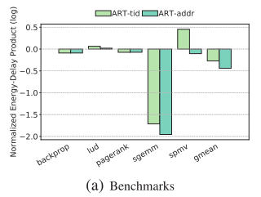
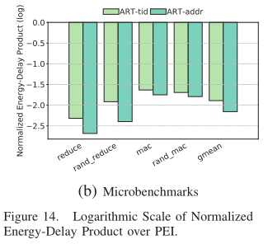
Evaluation
Energy-Delay Product
We observe that ART-tid/addr has lower EDP for all applications except for spmv with ART-tid.

Slide 24
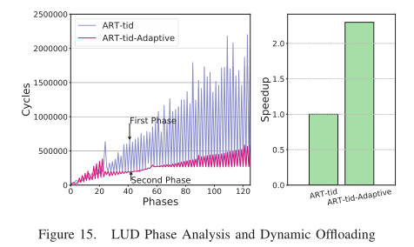
Evaluation
Dynamic Offloading: A Case Study
The performance can be further improved using a runtime knob. The runtime knob decides whether to offload computations (Updates) dynamically on the basis of memory access and communications patterns to achieve more performance gains.
lud: These two phases have different locality of data accesses. The second phase has a good data locality since its data access pattern is row-major order, whereas the data access pattern of the first phase is column-major order. For such a program behavior, the best execution model is to use Active-Routing for the first phase and process the second phase in the host processor.

Slide 25
Conclusion
Active-Routing, an in-network compute architecture, to accelerate reduction on data processing operations in data-intensive applications for near-data processing.
Active-Routing is implemented as a novel three-phase processing schedule, which offloads the computation near data in the memory network for execution and aggregates the results along their routing path.
We categorize memory access patterns of compute kernels of interest and offload the computations in various granularities by exploiting their locality characteristics to reduce offloading overhead.

Slide 26

Q & A
Thank You!

